Slide 1
Design of a Subsea Production Field
Spring 2014 Project Report
University of Houston
SUBS 6310: Flow Assurance
Instructor: Dr. Phaneendra Kondapi
Group: 20
Project Group:
Philip Kuentz
Satya Chandu Ganisetty
Akshay Patel
Amin Elhami

Slide 2
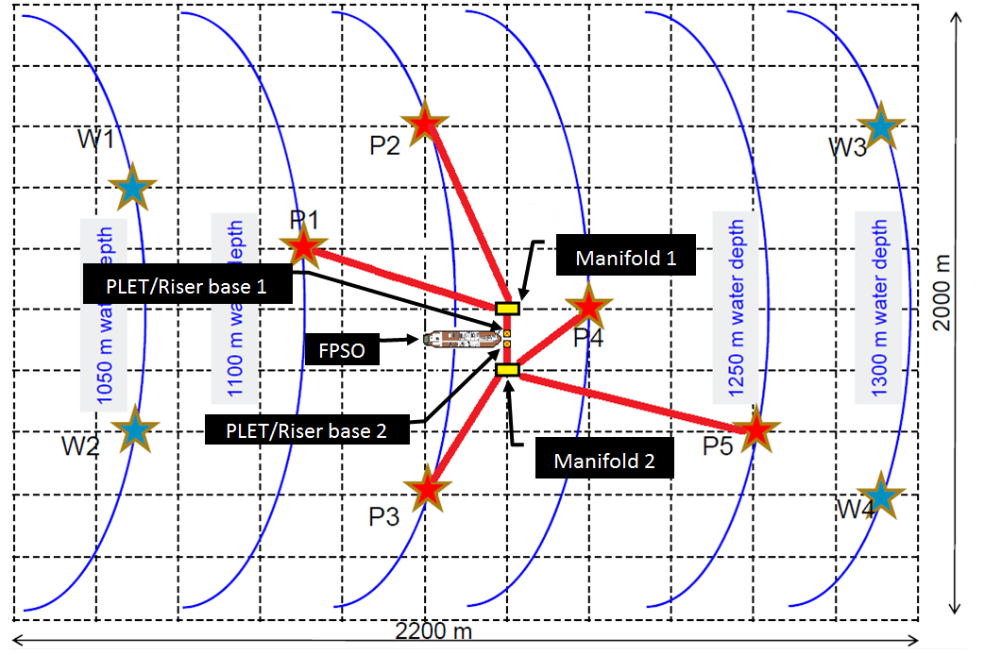
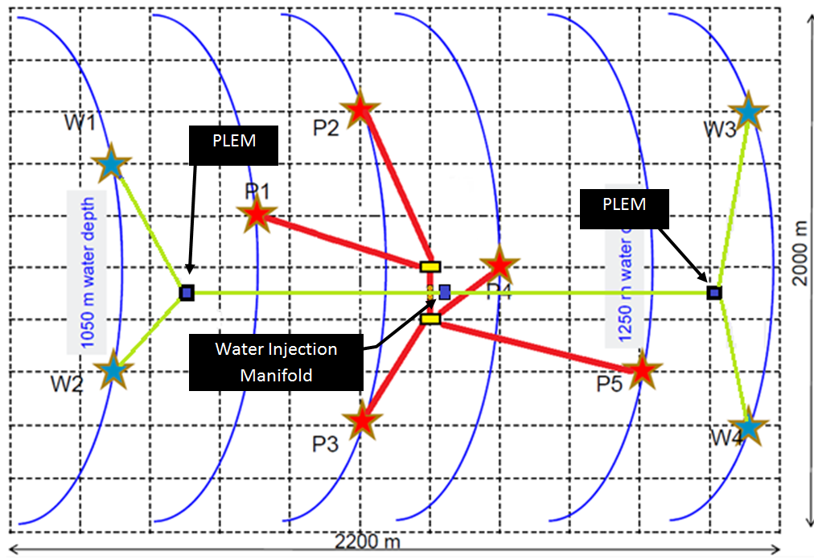
Field Layout- Production
Production
Water Injection

Slide 3
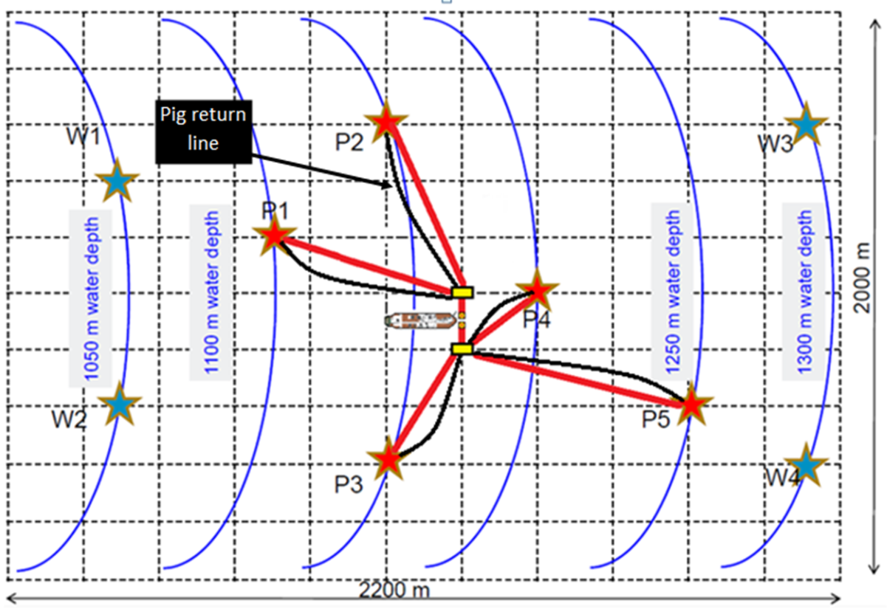
Flow Assurance Strategy
Size all tubular goods to avoid excessive fluid velocities.
Position manifold closer to low performance well (minimize temperature loss in flow line).
Minimize low temperatures solids formation in the flow lines and risers (utilize well 5 flow to ensure sufficient temperatures in flow-loop 2 riser).
Inject methanol and wax inhibitor down-hole in well 4. Inject at production tree all other wells.
Develop pig network for slug
and solids remediation.
Utilize thermal insulations for
the pipe lines to prevent wax.
Use pipe coating and choose
correct alloys according to the
cost and project lifetime.
Utilize depressurization and
active heating to remediate
possible flow assurance
problems.
Proposed Pig Network

Slide 4
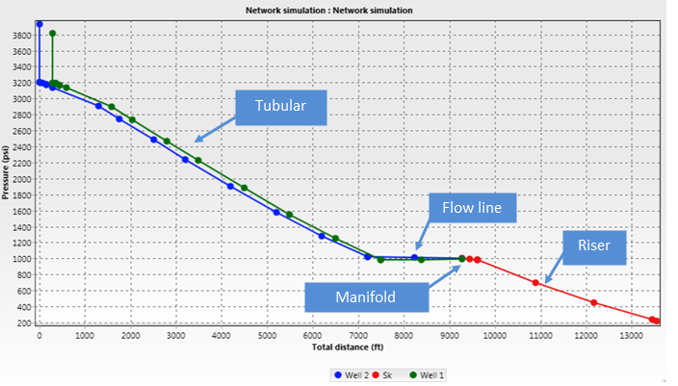
Pressure Profile- Wells P1 and P2
Pressure Profile, Early Life
Iteration 1: Comingle manifold at 940 PSI
 |  | Choke Bean | Pressure at Manidfold | Flow Rate at Manifold
Well 1 | 0.8 | Open | 940.6 | 4500.27
Well 2 | 0.86 | 2.5 | 940.528 | 3998.7
Riser ID | COMINGLED TOPSIDE PRESSURE | Topside pressure acceptable
9.5 | 208.42
Pressure Profile Results, Mid and Late Life
Iteration 1: Comingle manifold at 785 PSI (USE CHOKES)
 | Gas Injection | Choke Bean | Pressure at Manifold | Flow Rate at Manifold
Well 1 | 0.62 | 1.15 | 785.77 | 1200
Well 2 | 0.74 | 1.5 | 785.56 | 1994.3
Riser ID | COMINGLED TOPSIDE PRESSURE | Topside Pressure Acceptable
9.5 | 228.2

Slide 5
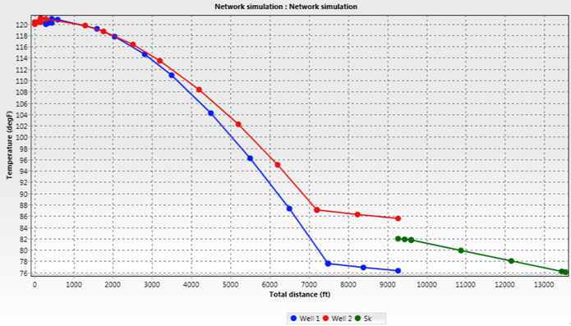
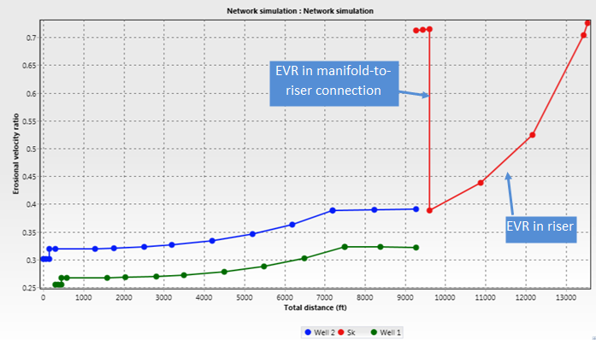
Temperature and EVR, Wells P1 and P2
Temperature Distribution, Wells 1 and 2, Coolest Case
Lowest temperature is 76.1°F topsides.
Erosional Velocity Ratio, Wells 1 and 2, Early Life (Worst Case)

Slide 6
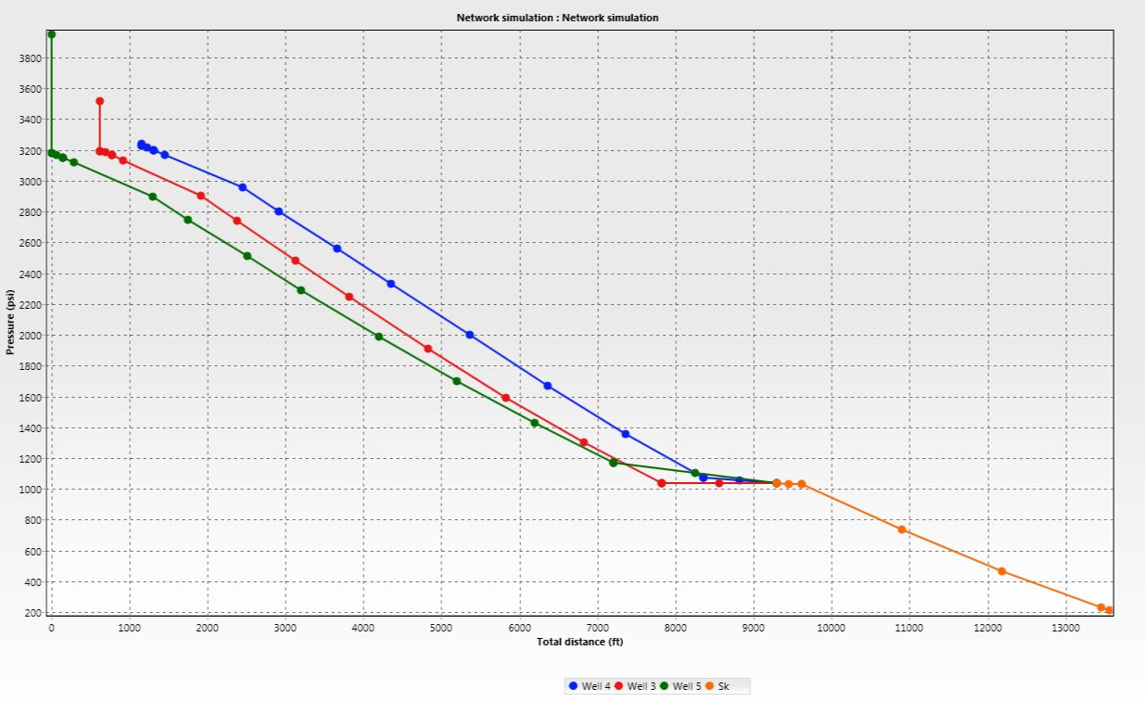
Pressure Profile- Wells P3, P4, and P5
Pressure Profile, Early Life
Commingle at 1000 psi
 | Gas Injection | Choke Bean | Pressure at Manifold (psi) | Flow Rate at Manifold (STB/d)
Well 1 | 0.71 | Open | 1002 | 8874.73
Well 2 | 0.29 | Open | 1025
Well 3 | 2 | Open | 1002.89
Riser ID | COMINGLED TOPSIDE PRESSURE | Required topside pressure met with 7.5" riser.
7.5 | 219.98
Pressure Profile Results, Mid and Late Life, Wells 3, 4, and 5
Commingle at 1000 psi
 | Gas Injection | Choke Bean | Pressure at Manifold (psi) | Flow Rate at Manifold (STB/d)
Well 1 | 0.48 | Open | 804.31 | 3406.23
Well 2 | 0.26 | Open | 1025.72
Well 3 | 0.81 | Open | 814.18
Riser ID | COMINGLED TOPSIDE PRESSURE | Required topside pressure met with 7.5" riser.
7.5 | 205.29

Slide 7
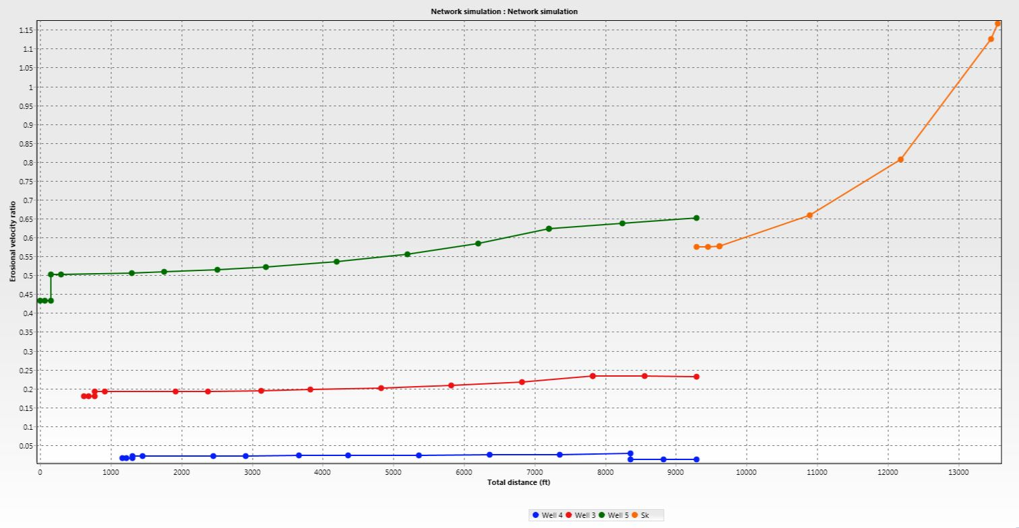
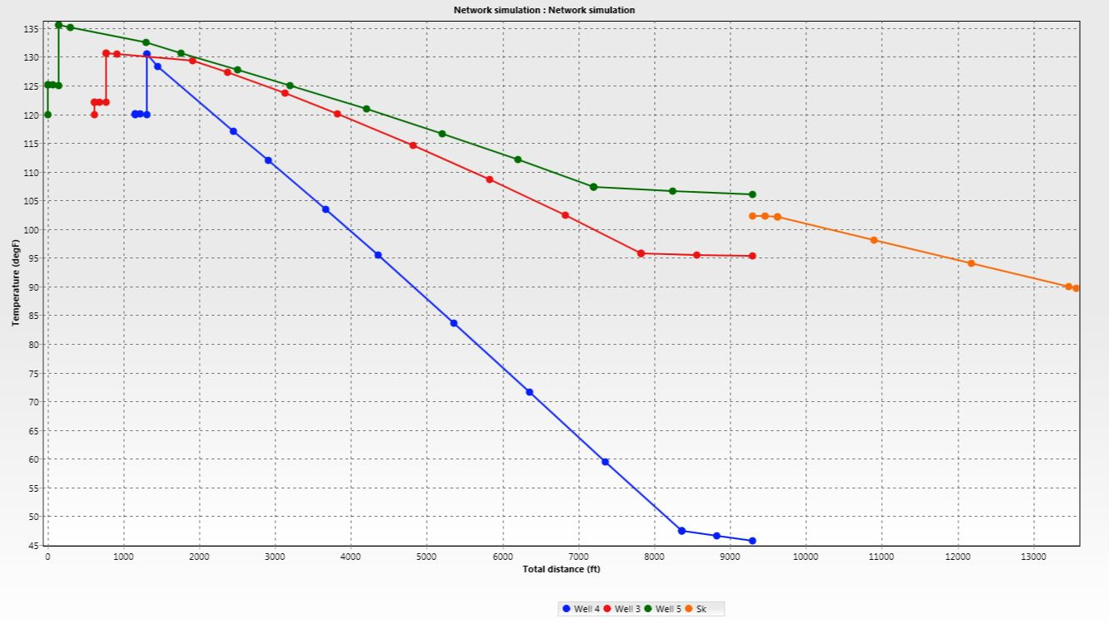
Temperature and EVR, Wells 3, 4, 5 Early Life (Worst Case)
Temperature Distribution, Wells 3, 4, 5 Coolest Case
Lowest temperature is ~46°F well 4 branch at manifold.
Erosional Velocity Ratio, Wells 3, 4, 5 Early Life (Worst Case)

Slide 8
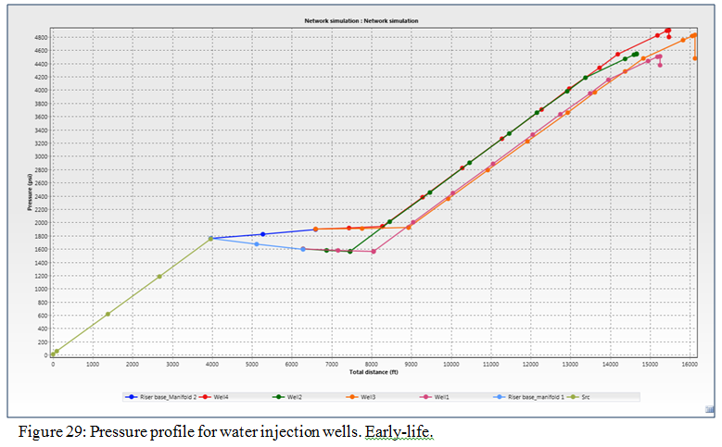
Water Injection Study Results

Slide 9
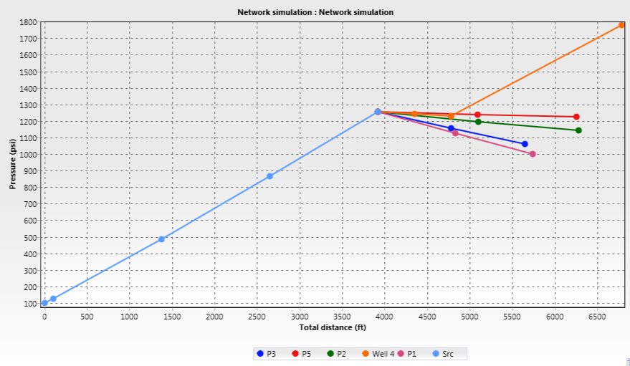
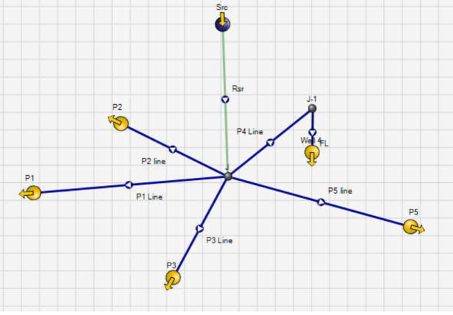
Methanol Injection
Umbilical ID- 1.5”
FL 1 ID- 0.5”
FL 2 ID- 0.6”
FL 3 ID- 0.5”
FL 4 ID- 0.6”
FL 5 ID- 0.65”
Pressure profile: Early
Pump Pressure Early: 100 psi
Pump Pressure Mid: 55 psi
Pump Pressure Late: Atmospheric

Slide 10
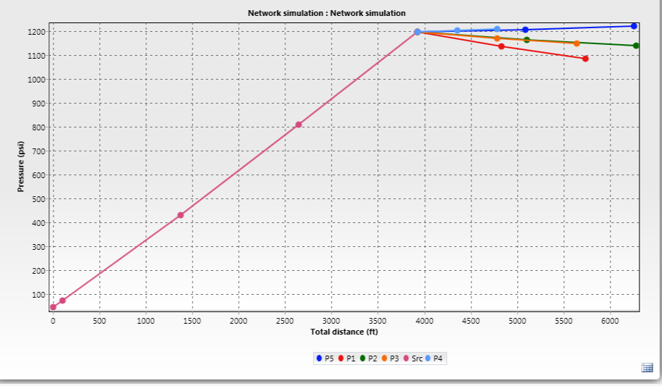
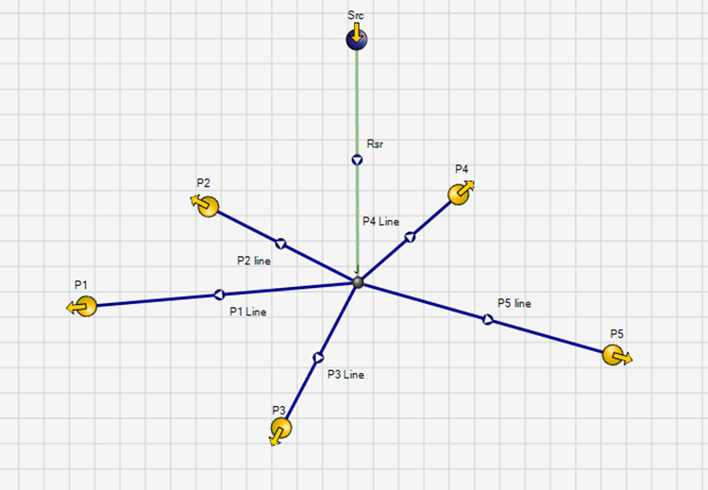
Corrosion Inhibitor Injection
Umbilical ID- .65”
FL 1 ID- 0.5”
FL 2 ID- 0.5”
FL 3 ID- 0.5”
FL 4 ID- 0.5”
FL 5 ID- 0.5”
Pressure profile: Early
Pump Pressure Early: 45 psi
Pump Pressure Mid: Atmospheric
Pump Pressure Late: Atmospheric

Slide 11
Recommendations
Use MUX-based control system.
Use adequately sized slug catcher.
Use topside chokes that are controlled remotely to handle slugs.
Utilize active monitoring system such as FlowManger.
Utilize wax inhibitors at cool points in system (well 4, down-hole, well 5 flow line, late life).
Continual use of methanol.
Use of sample tests to precisely examine our fluid properties to determine solids and associated formation risks.
Capability of electrical heating on flow lines.
Low dosage inhibitors to combat hydrates.
Implement pigging network for solids remediation and removal of system water.
Consider the use of subsea separators to optimize production and minimize flow assurance problems.

